Slide 1


Slide 2
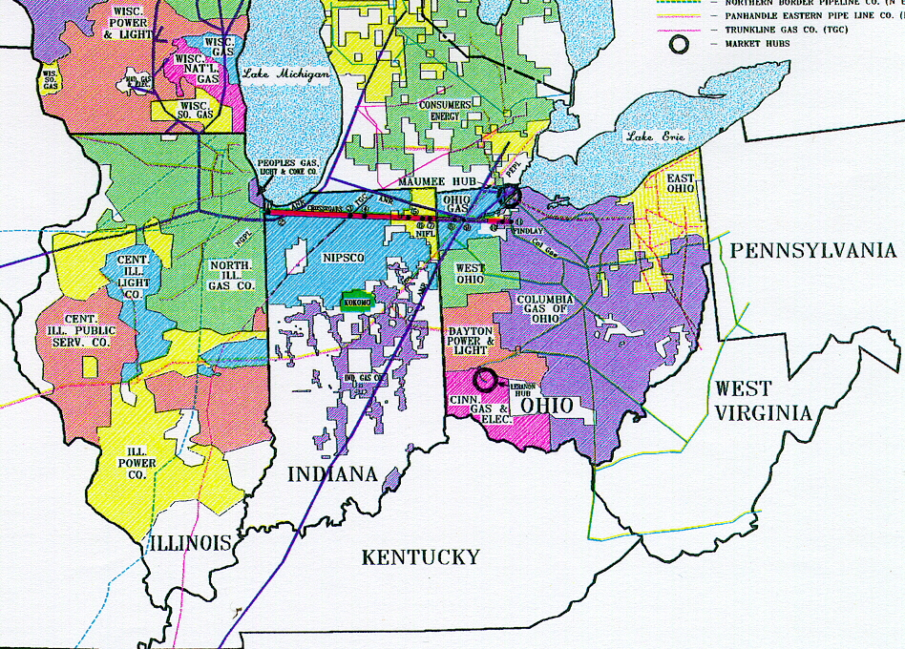
Market Area Map

Slide 3
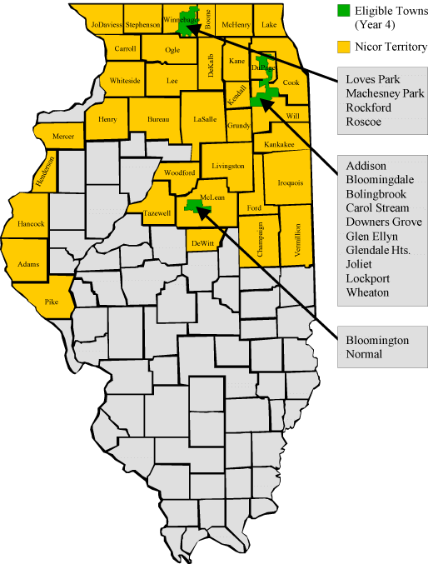
Nicor Gas Service Territory
Operates a 29,000 mile distribution system connected to 7 interstate pipelines serving 2 million customers in the northern third of Illinois, excluding the city of Chicago.

Slide 4
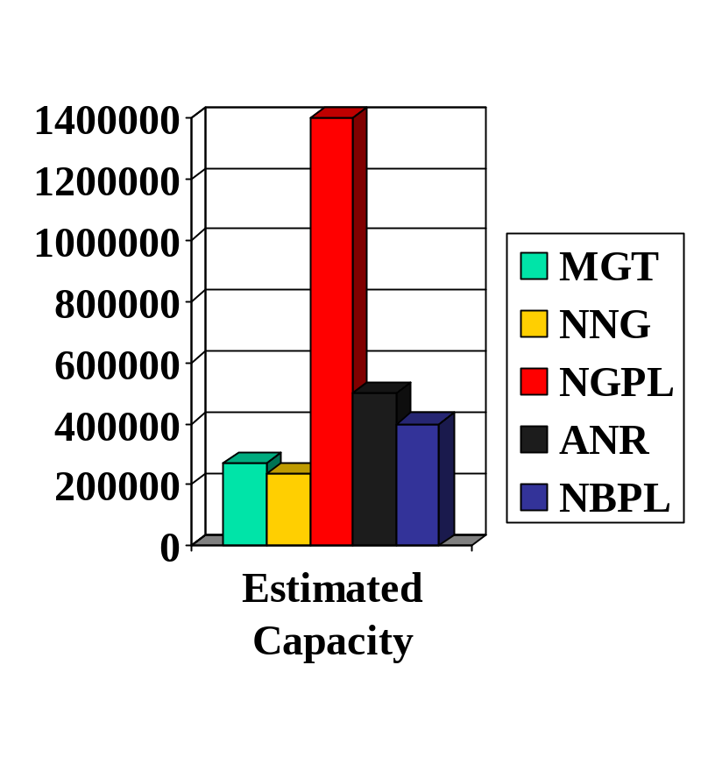
Nicor Interconnects
Midwestern – E. Joliet (027081)
NNG – E. Dubuque (234)
NGPL – Nigas Central Point (9258)
Skokie – PGLC (NIG)
ANR – Shorewood (138675)
NBPL – Minooka (227975)
APLP – NIG/APLP Morris (NMRLS)

Slide 5
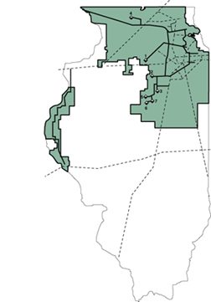
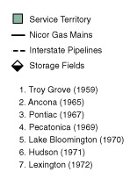
Nicor Storage Facilities
7 Underground storage facilities with approximately 165 bcf of storage capacity.
Approximately 50% to 60% of peak day needs and about 1/3 of annual deliveries can be met from storage

Slide 6

Nicor Deadlines
11:30 am Prior to day of gas flow Tues thru Fri
11:30 am Friday for gas flow Sat thru Mon
Holidays Deadline Dates
  Tue, 1/1/02 11:30 am 12/29/01 for 1/1, 1/2
  Fri, 3/29/02 11:30 am 3/28 for 3/29, 3/30, 3/31, 4/1
  Mon, 5/27/02 11:30 am 5/24 for 5/25, 5/26, 5/27, 5/28
  Thu, 7/4/02 11:30 am 7/3 for 7/4, 7/5
  Mon, 9/2/02 11:30 am 8/30 for 8/31, 9/1, 9/2, 9/3
  Thu/Fri, 11/28-11/29 11:30 am 11/27 for 11/28, 11/29, 11/30, 12/1, 12/2
  Tue/Wed, 12/24-12/25 11:30 am 12/23 for 12/24, 12/25, 12/26
THERE ARE NO INTRADAY NOMINATIONS!!

Slide 7

Critical Day
A “critical” day may be declared when any of the following five conditions occur or is anticipated to occur:
  Failure of transmission, distribution, gas storage or gas manufacturing facilities
  Transmission system pressures or other unusual conditions jeopardize the operation of the system
  Transmission, storage and supply resources are being used at or near the maximum rated deliverability
  Transporters or suppliers call the equivalent of a Critical Day
  Nicor is unable to fulfill their firm contractual obligations or it is necessary to maintain the overall operational integrity of all or a portion of the system.
A “critical” day will be declared by 8 am the day before flow. Nicor will notify customers by posting a notice on Gas Exchange and on the recorded message line.

Slide 8

Penalties
Per Nicor’s tariff, penalties apply only to system customers (end users) not marketers shipping to the gate. Penalties imposed to Nicor customers can and may be passed on to marketers initiating cuts per the discretion of the customer(s).
Under Deliveries
  Nicor will sell the higher of the Rider 6 Gas Supply cost or the market price + the sum of $60.00 per mmbtu
  As an example, a reduction of 200 mmbtu could result in a $12,000 penalty.
Over Deliveries
  Nicor will purchase the gas at 100% of the low price reported for Chicago City Gate deliveries reported by Gas Daily for each day of non performance. If Gas Daily is not available another similar publication will be used as determined by Nicor’s sole discretion. Due to nominating procedures, only end users are allowed over deliveries.

Slide 9
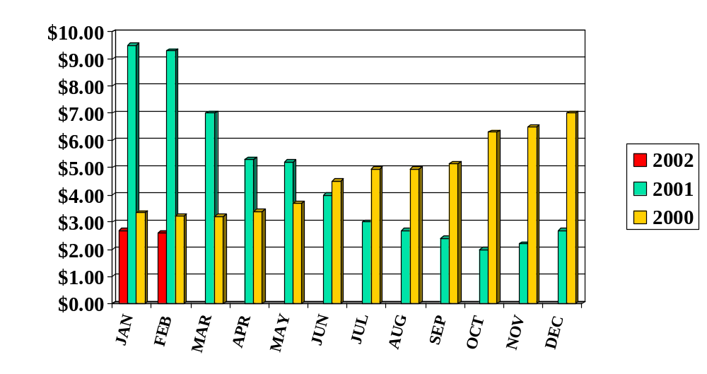
Nicor Gas Supply Historical Gas Cost per mmbtu

Slide 10

Nominating in the Nicor World
All counter parties have Broker Id’s and are input into unify via the “alias GID per counter party”
Pools are broken out by pipeline and must be balanced before sending nomination.
Nicor does not require upstream contract numbers on transport
Nicor will not allow increases to volumes after the 11:30 deadline. Any balancing after the 11:30 deadline is handled through the Nicor Hub on an “as available” basis.

Slide 11
Nicor Contacts
Pat Hollan – Nomination Rep
  630/983-4040 opt 2
Greg Love – Nicor Hub Rep
  630/983-8676 x 2348
Greg Starcy – Gas Control
  630/983-8676 x 2253
Critical Day Notification
  630/983-4040 opt 1
Customer Service
  630/983-4040 opt 1

Slide 12

Direct connections with 6 major pipelines:
  ANR
  NGPL
  NBPL
  NNG
  MGT/TGP
  PEPL
Services provided at negotiated rates based on current market conditions
Made possible through use of Nicor’s 7 underground storage facilities

Slide 13
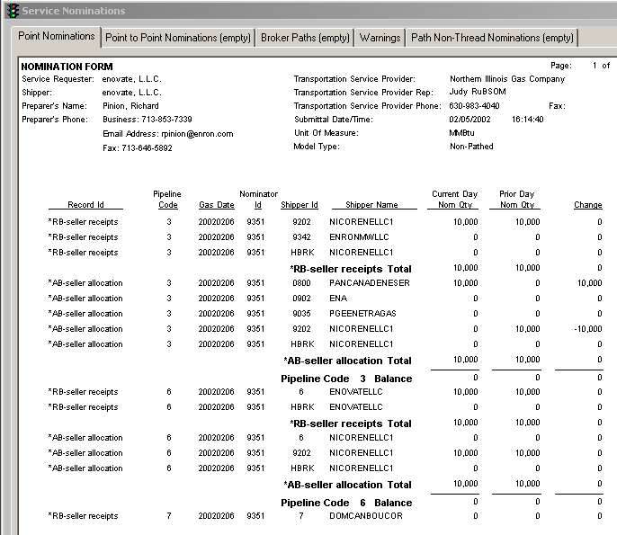
Nicor Nomination in Unify

Slide 14
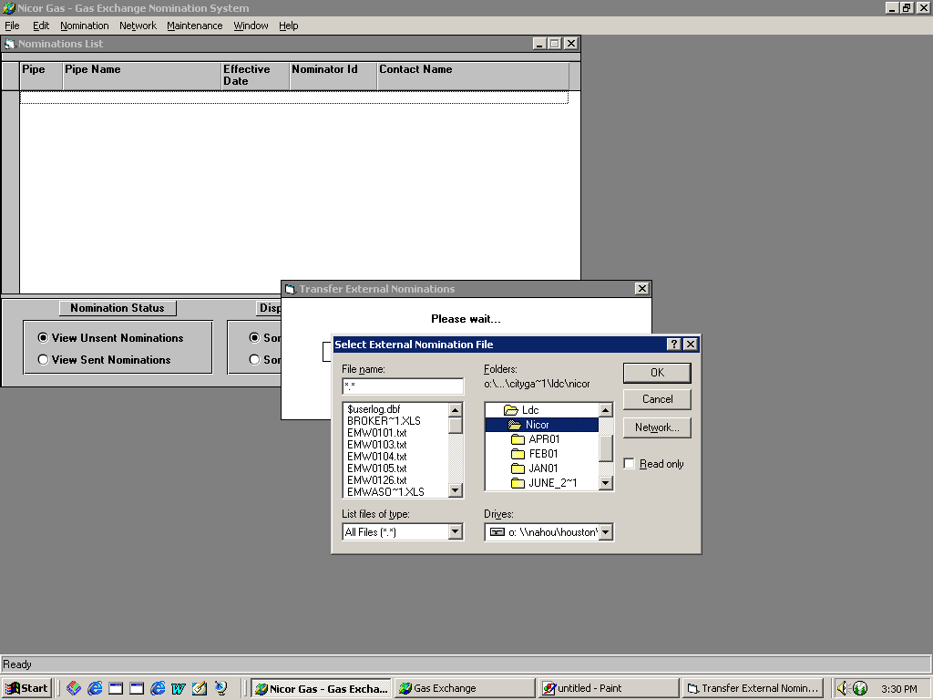
Nicor Gas Exchange

